Slide 1

Women’s leadership Forum
WILL – July 17, 2019 | Shiv - ABG

Slide 2

Today about 5% of Fortune 500 or S & P 500 CEOs are women. It has been 5 % for the last ten years!!

Slide 3

India is no different !!

Slide 4
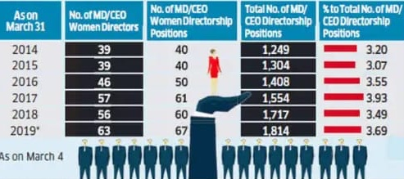
3.69 %
Source : ET, March 2019

Slide 5

There is a lot of talk, why aren’t things changing/moving?

Slide 6

Some possible reasons
Society hasn’t changed much in the way they see roles of women and men
There aren’t enough women at the lower & middle levels for a strong pipeline to develop – drop offs
Women have to think of the social side of how organizations work.

Slide 7

Men and Women are different at work………..
Let’s look at 8 dimensions
Statutory warning: This doesn’t mean that all
men are this and all women are that…
This is illustrative to make a point/reflect

Slide 8
Power
Men
Crave It
Dominate
Women
Shy
Wear it lightly

Slide 9
Networking
Men
It is Like a habit
Women
Fewer to network
Cultivate mutuality
Is out of the way

Slide 10
Meetings
Men
Aim to impress
Women
To contribute
Rarely change their POV
Willing to change POV

Slide 11
Gossip
Men
Play to win
Play to hurt
Women
To Manage it
Step aside if messy

Slide 12
Compensation
Men
Fight for more. ‘I think this is unfair”
Women
Settle for less. ‘I hope it is fair’

Slide 13
Aggression
Men
Seen as assertive. ‘He is decisive’
Women
Seen as bossy. ‘She is authoritarian’

Slide 14
Credit
Men
First in line to take credit (ATM-All Thanks to Me)
Women
First in line to share credit

Slide 15
Ambition
Men
Wear it on their sleeves. ‘He is hungry’
Women
Don’t show it. ‘Does she want the job?’

Slide 16

The idea is not to mimic men but to find the right expression of the dimension that gets you ahead in today’s world that needs it.

Slide 17

3 watch outs
1
2
3

Slide 18

Watch out 1: Lack of Operational Roles?

Slide 19

Watch out 2: Lack of sponsors?

Slide 20

Watch out 3: Glass ceiling or Glass cliff?

Slide 21

Summary

